Slide 1
2024 PHM Conference Tutorial
Probabilistic Deep Learning
Dr. Jesse Williams
GTC Analytics, CTO/VP of Digital Engineering
jwilliams@gtcanalytics.com
Actionable Intelligence through Analytics

Slide 2
Tutorial Overview
About me
Multi-model machine learning
Multi-model deep learning
Maskensemble deep learning
Application to the 2024 Data Challenge
Extra: TensorFlow Probability

Slide 3
About Me
GTC Analytics
CTO / VP of Digital Engineering
LIM Innovations
CTO / VP of Engineering
National Institute for Materials Science (Japan)
Lead scientist
UC Santa Barbara
PHD
Los Alamos National Laboratory
Undergraduate researcher

Slide 4
Probabilistic Estimation of Seismic Response Using Physics-Informed Recurrent Neural Networks
Idaho National Laboratory
Georgia Tech
Deep Learning Probabilistic Regression for Onset Time Determination
AFTAC
Stanford
SIREN: Seismic & Infrasound Intelligence for Rocket-Launch Event Notification
US Space Force
Machine Intelligence for Nuclear Explosion Monitoring
Applied Research Associates
Machine Learning Methods to Catalog Source from Diverse, Widely Distributed Sensor
AFRL
Georgia Tech
RaNDL: Rapid Nuclear and seismic events Discriminator and Locator
AFRL
Georgia Tech
MobiQkRad – Real Time Source Localization with Contextual Information
DHS
Decentralized Data Fusion Algorithm for Multisensor Radiation Source Search
DTRA
Oak Ridge National Laboratory
Model-Based Enterprise Architecture for Institutional Management Digital Twins
NASA
Georgia Tech
Enabling Digital Metrology and Manufacturing Through the Model-Based Enterprise
NAVAIR
University of Georgia
Digital Twin Technologies to Improve Mission Readiness and Sustainment
NAVAIR
Vanderbilt
ARADISS: Adaptive Real-time Anomaly Detection & Identification for Space Systems
NASA
University of Colorado, Boulder
Real Time Cybersecurity Systems for Safety Critical Military Vehicle Applications
US Army
University of Michigan
TRAIT: Transition-pipeline Recommender & Attrition Identification Tool
NAVAIR
Georgia Tech
US Navy Postgraduation School
Advanced Analysis of Nuclear Waste Storage Cask Health
Virginia Tech
TRACAIR: TRAjectory Course analyzer and Anomaly IdentifieR
NASA
Georgia Tech
Seismic AI in RealTime for Informed Drilling and Fracking
DOE
Georgia Tech
Operation-Aware ISHM for Environmental Control and Life Support in Deep Space Habitants
NASA
University of South Carolina
Resource Management Strategies for a Resilient Habitat Advanced Life Support (ALS) System
NASA
Georgia Tech

Slide 5
Probabilistic DL Basic Concepts
Ensemble method
Many models each with their own
History/beliefs
When inference is “easy”
Models predict similar estimation
When inference is “hard”
Model predictions diverge
Inference confidence can be correlated to
Predict standard distribution

Slide 6
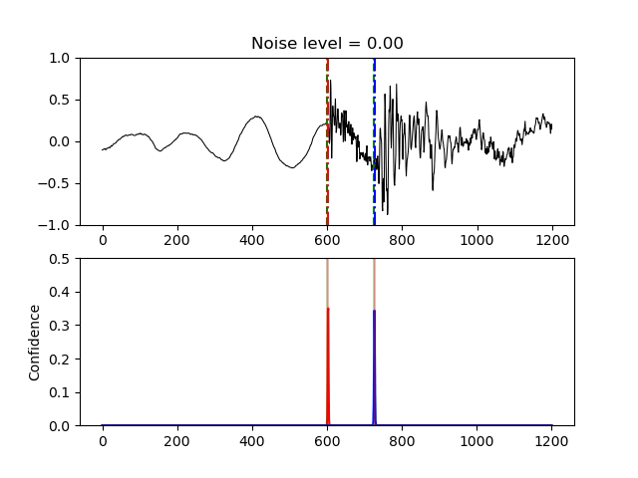
Probabilistic DL Basic Concepts

Slide 7
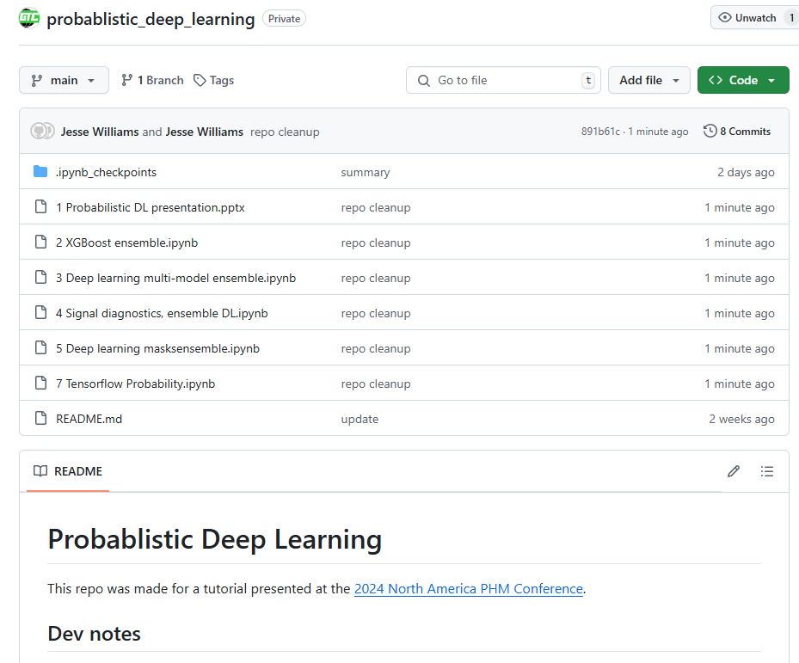
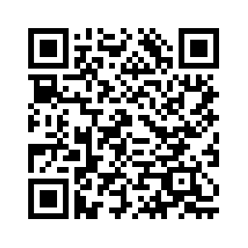
Tutorial Resources
https://github.com/globaltechinc/probablistic_deep_learning

Slide 8
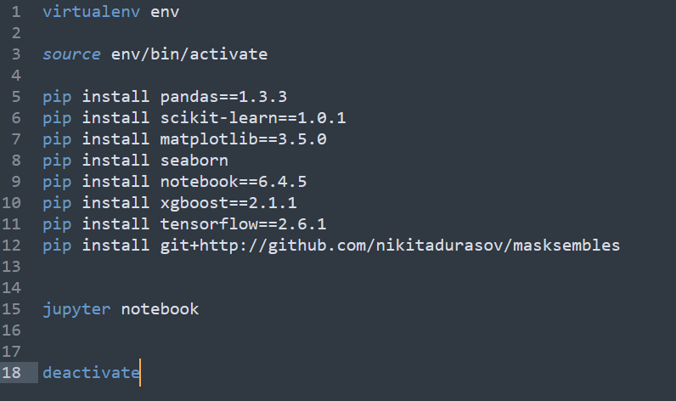
Environment Setup

Slide 9
Multi-model Machine Learning
Notebook: 2 XGBoost ensemble

Slide 10
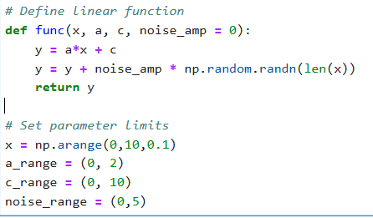
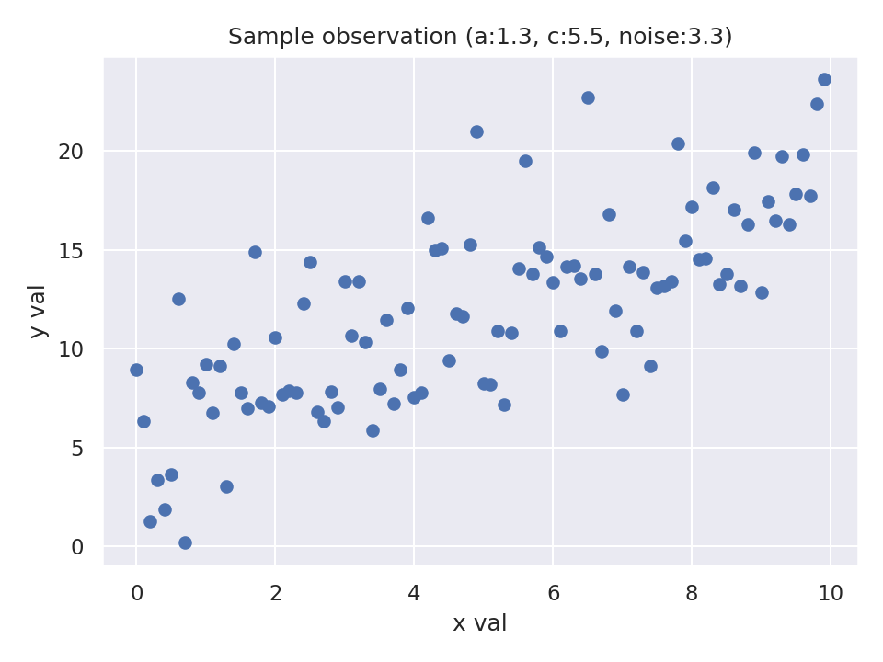
Multi-model Machine Learning: RUL Est.
Create the dataset generator

Slide 11
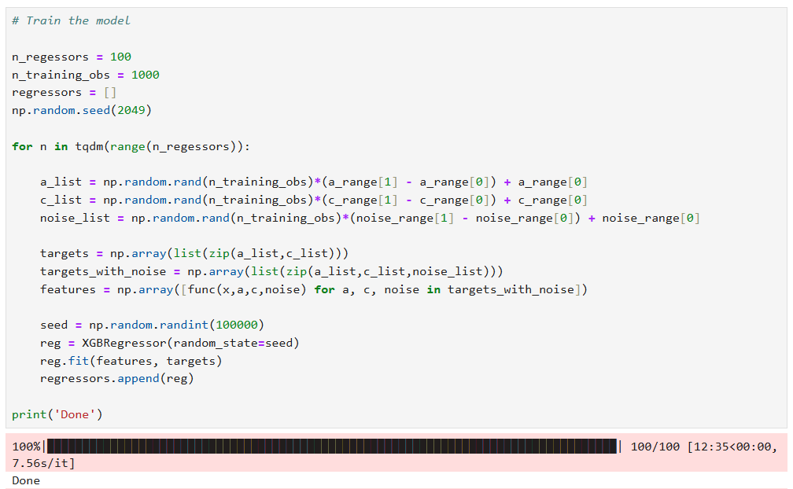
Multi-model Machine Learning: RUL Est.
Train an ensemble of models

Slide 12
Multi-model Machine Learning: RUL Est.
Train an ensemble of models
Setup

Slide 13
Multi-model Machine Learning: RUL Est.
Train an ensemble of models
Looping with visibility

Slide 14
Multi-model Machine Learning: RUL Est.
Train an ensemble of models
For each model
Create a unique training dataset

Slide 15
Multi-model Machine Learning: RUL Est.
Train an ensemble of models
For each model
Define features and targets

Slide 16
Multi-model Machine Learning: RUL Est.
Train an ensemble of models
For each model
Define features and targets

Slide 17
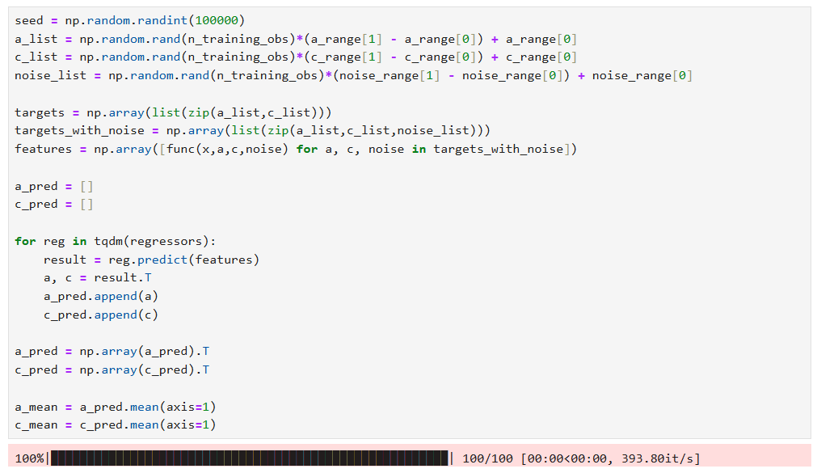
Multi-model Machine Learning: RUL Est.
Test an ensemble of models

Slide 18
Multi-model Machine Learning: RUL Est.
Test an ensemble of models
Build new dataset

Slide 19
Multi-model Machine Learning: RUL Est.
Test an ensemble of models
Each model performs inference

Slide 20
Multi-model Machine Learning: RUL Est.
Test an ensemble of models
Evaluate inference statistics

Slide 21
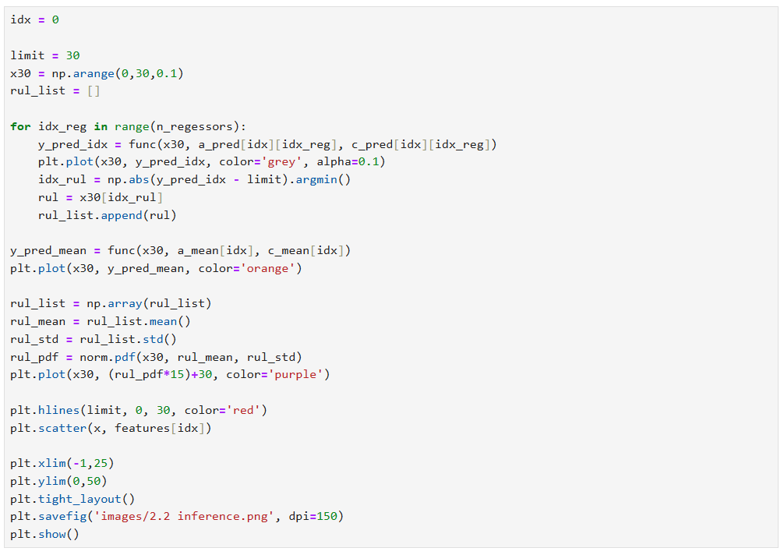
Multi-model Machine Learning: RUL Est.
Sample test inference

Slide 22
Multi-model Machine Learning: RUL Est.
Sample test inference
Consider RUL to x=30
Individual model pred.
Predicted mean
Normal PDF of all RULs

Slide 23
Multi-model Machine Learning: RUL Est.
Sample test inference
Consider RUL to x=30
Individual model pred.
Predicted mean
Normal PDF of all RULs

Slide 24
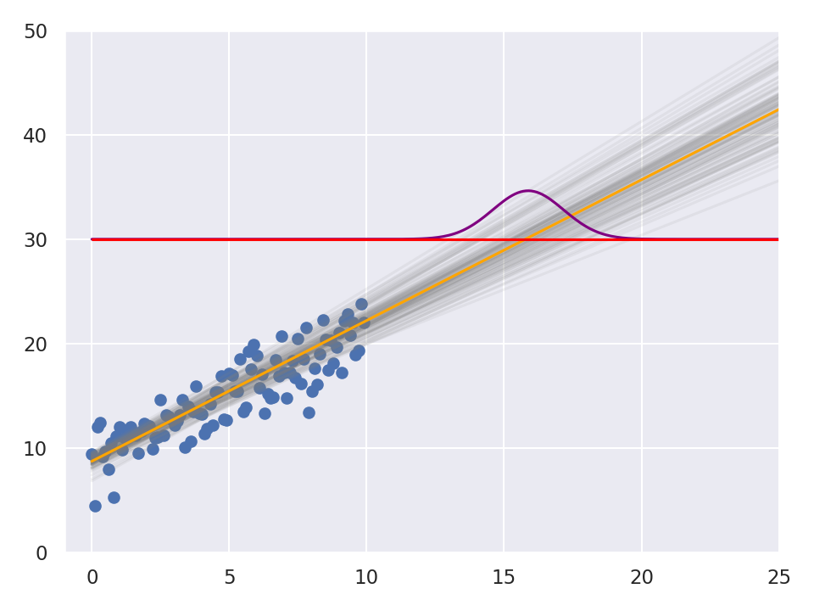
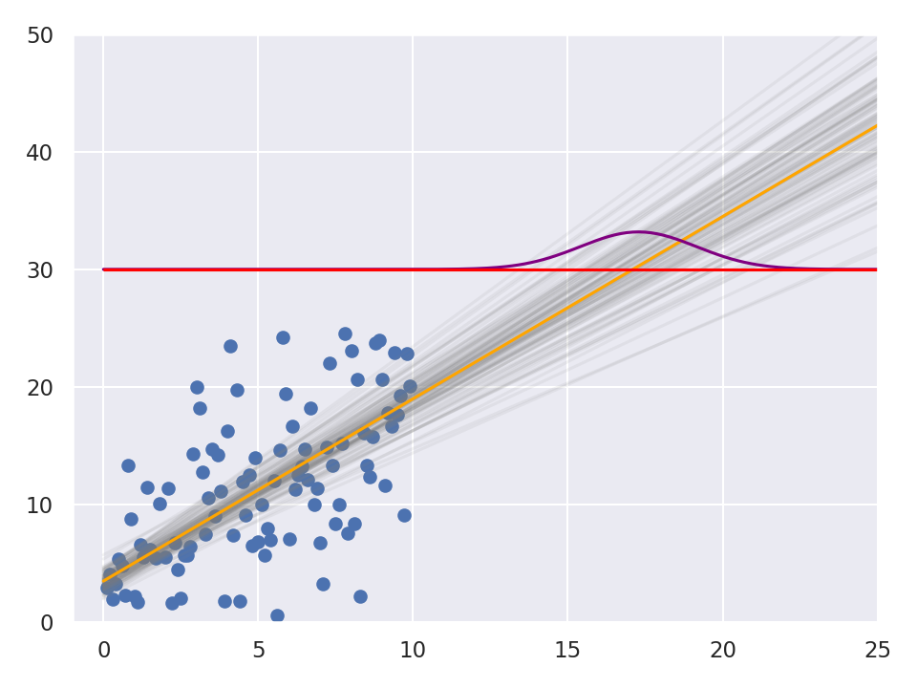
Multi-model Machine Learning: RUL Est.
Sample test inference

Slide 25
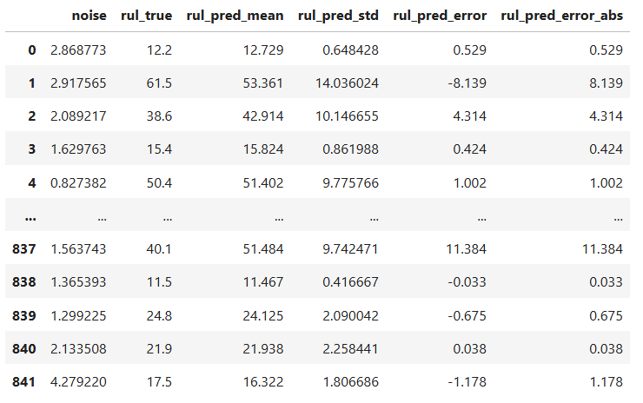
Multi-model Machine Learning: RUL Est.
Correlating predicted STD to error

Slide 26
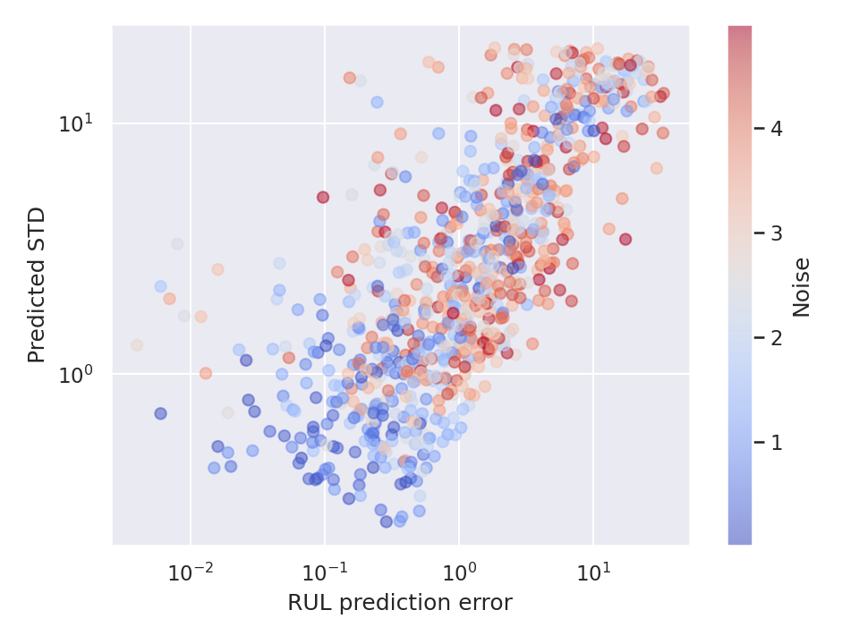
Multi-model Machine Learning: RUL Est.
Correlating predicted STD to error

Slide 27
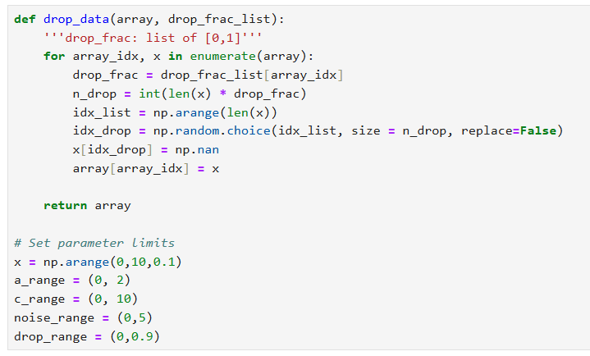
Multi-model Machine Learning: RUL Est.
Working with dropped or missing data

Slide 28
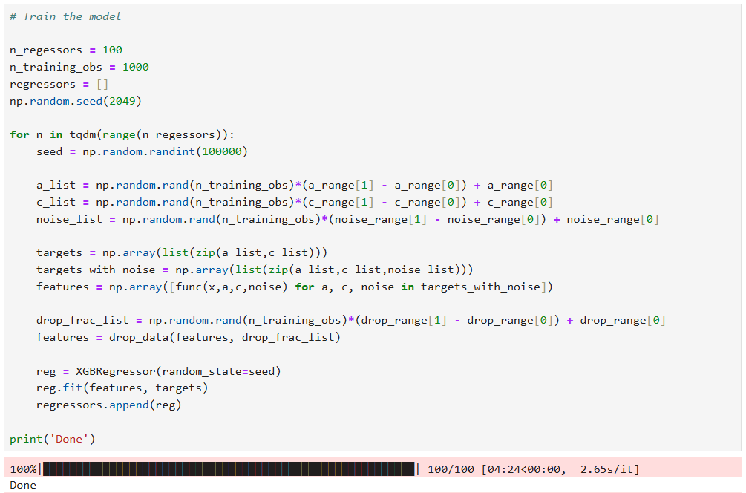
Multi-model Machine Learning: RUL Est.
Working with dropped or missing data
Drop data in the features

Slide 29
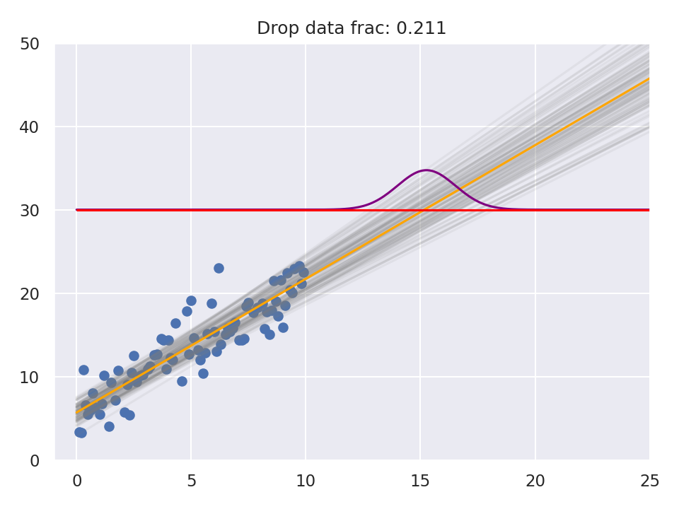
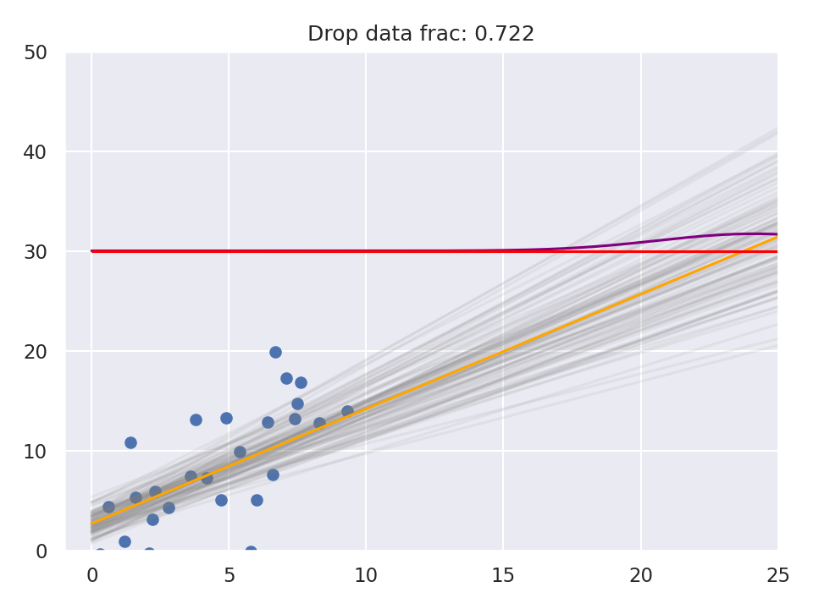
Multi-model Machine Learning: RUL Est.
Working with dropped or missing data

Slide 30
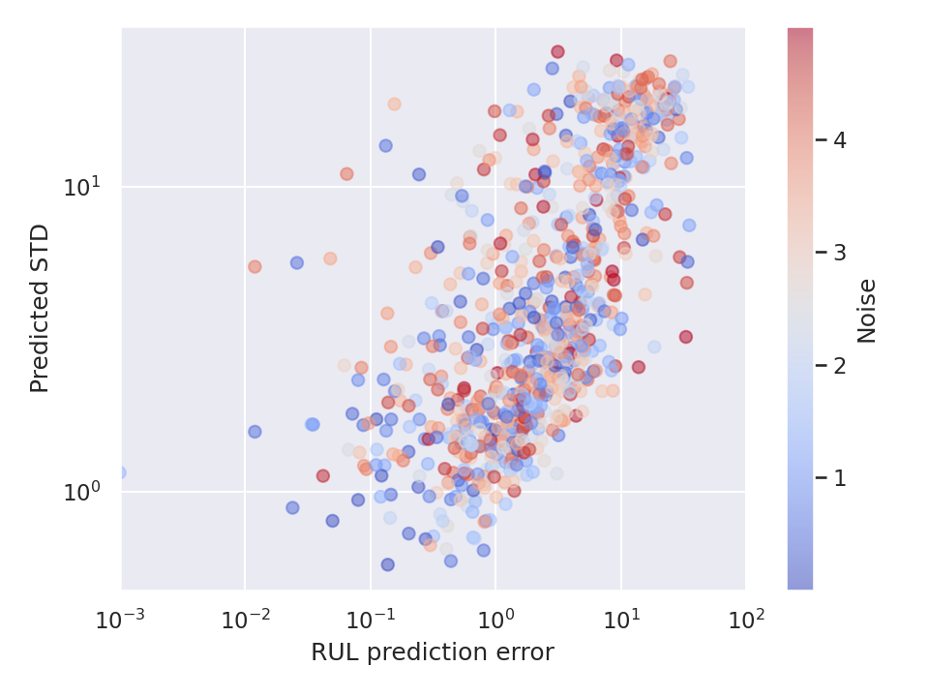
Multi-model Machine Learning: RUL Est.
Working with dropped or missing data

Slide 31
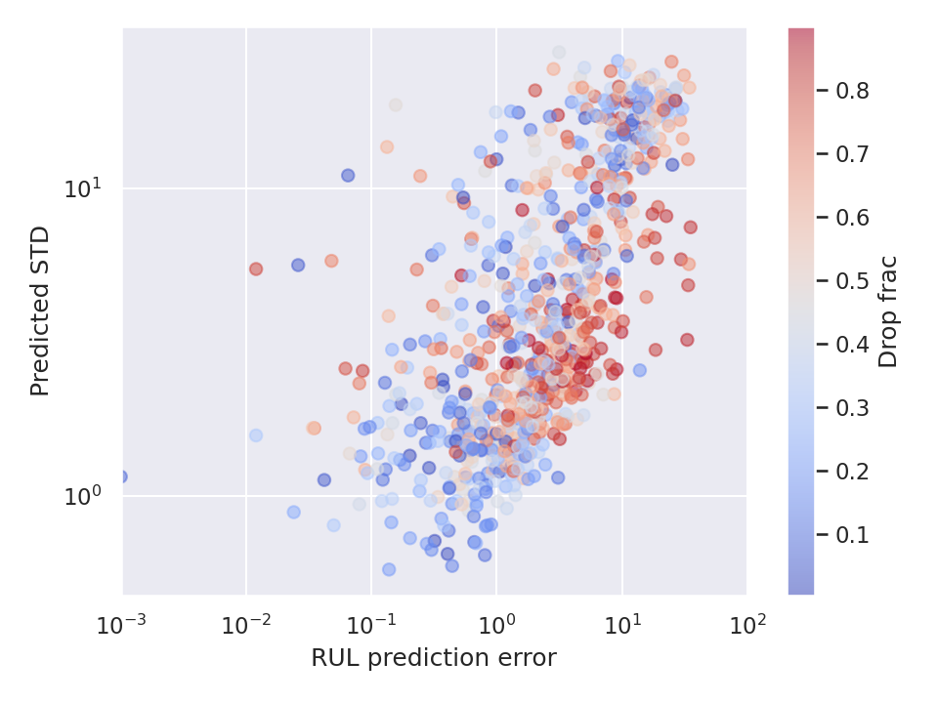
Multi-model Machine Learning: RUL Est.
Working with dropped or missing data

Slide 32
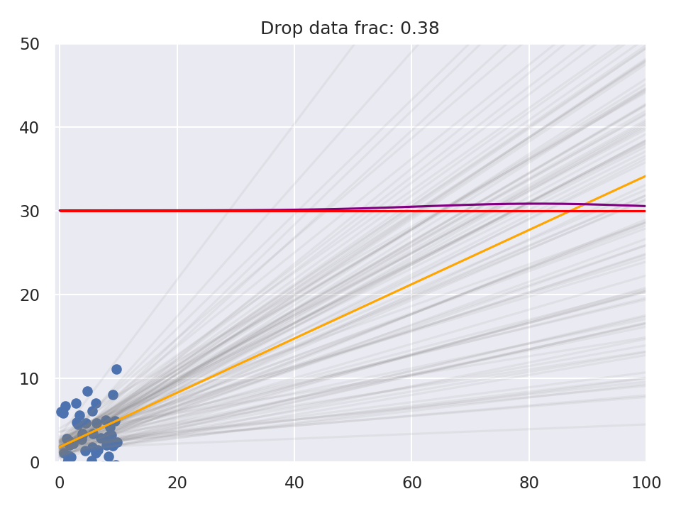
Multi-model Machine Learning: RUL Est.
Working with dropped or missing data

Slide 33
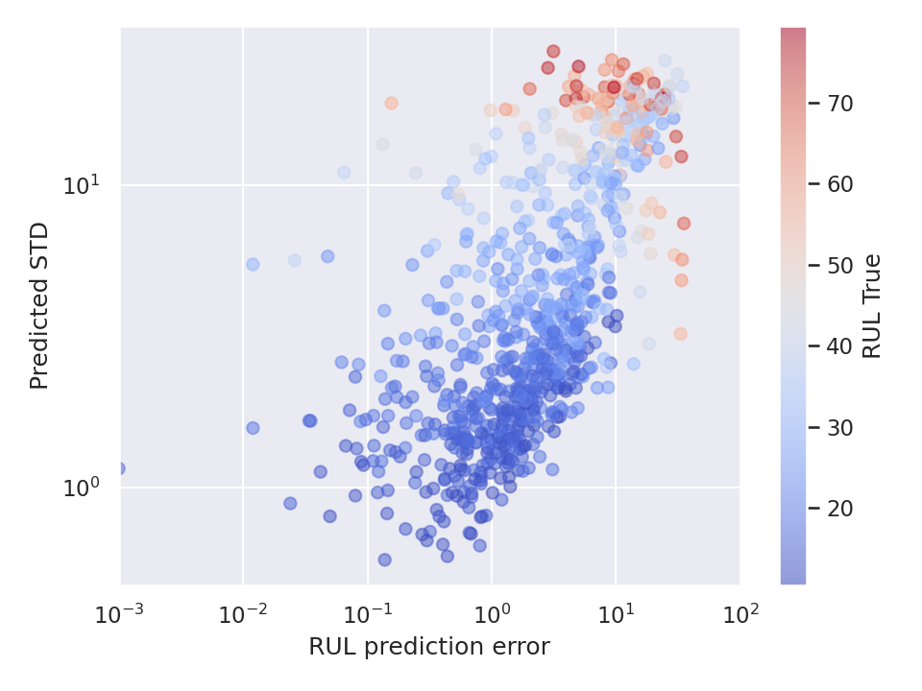
Multi-model Machine Learning: RUL Est.
Working with dropped or missing data

Slide 34
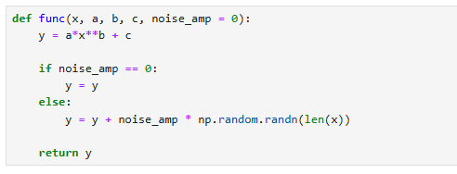
Multi-model Machine Learning: RUL Est.
Non-linear RUL

Slide 35
Multi-model Machine Learning: RUL Est.
Non-linear RUL

Slide 36
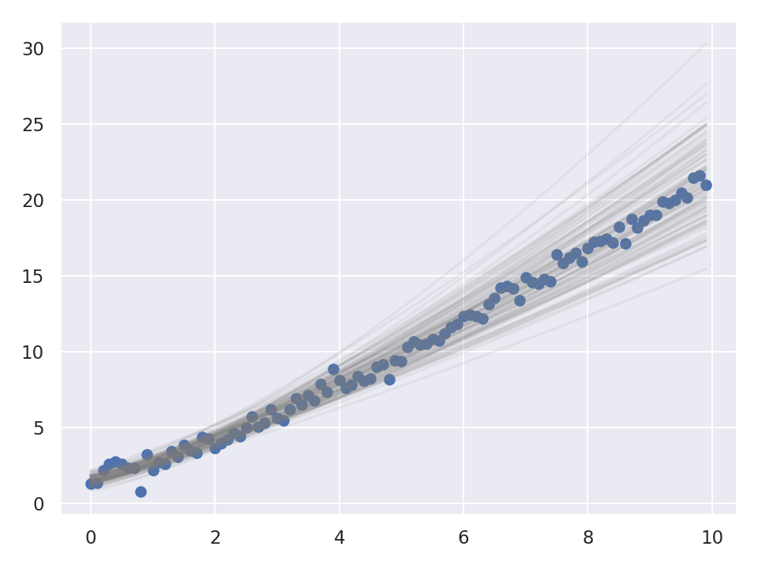
Multi-model Machine Learning: RUL Est.
Non-linear RUL

Slide 37
Multi-model Machine Learning: RUL Est.
XGBoost Recap
Multi-variable regression with XGBoost
Train multiple models
Unique data for each model-training set (unique experience)
Dropped/missing data is okay
Non-linear functions are okay

Slide 38
Multi-model Deep Learning
Notebook: 3 Deep learning multi-model ensemble

Slide 39
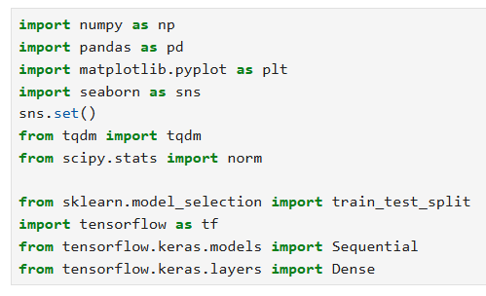
Multi-model Deep Learning: RUL Est.
Examples will be with TensorFlow

Slide 40
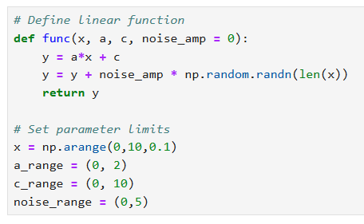
Multi-model Deep Learning: RUL Est.
Same linear RUL example

Slide 41
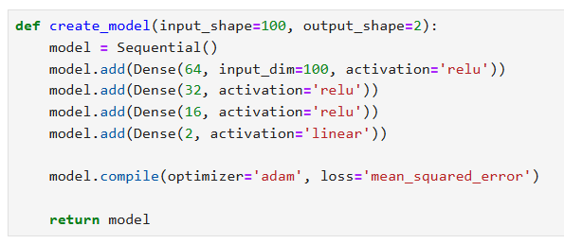
Multi-model Deep Learning: RUL Est.
Create basic dense MLP

Slide 42
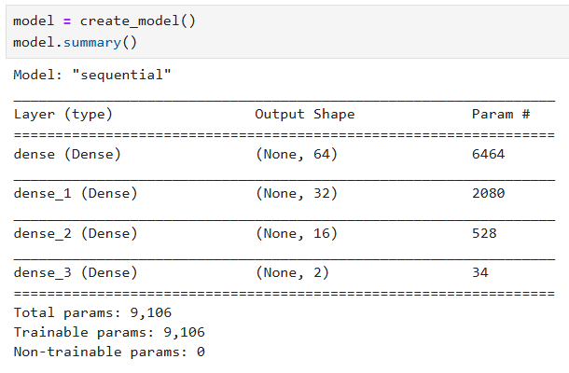
Multi-model Deep Learning: RUL Est.
Create basic dense MLP

Slide 43
Multi-model Deep Learning: RUL Est.
Create basic dense MLP

Slide 44
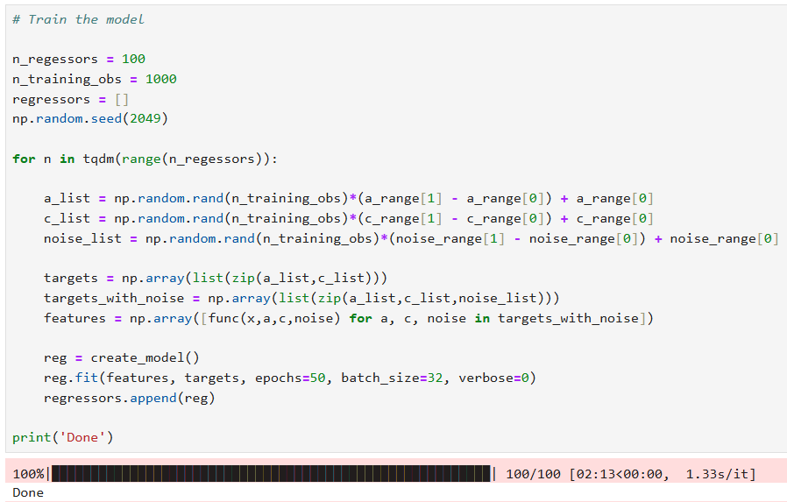
Multi-model Deep Learning: RUL Est.
Train an ensemble of models

Slide 45
Multi-model Deep Learning: RUL Est.
Train an ensemble of models
Update from previous code

Slide 46
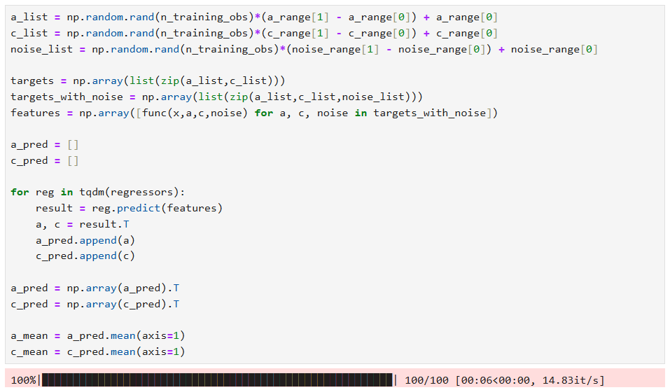
Multi-model Deep Learning: RUL Est.
Test an ensemble of models
Code unchanged from previous example

Slide 47
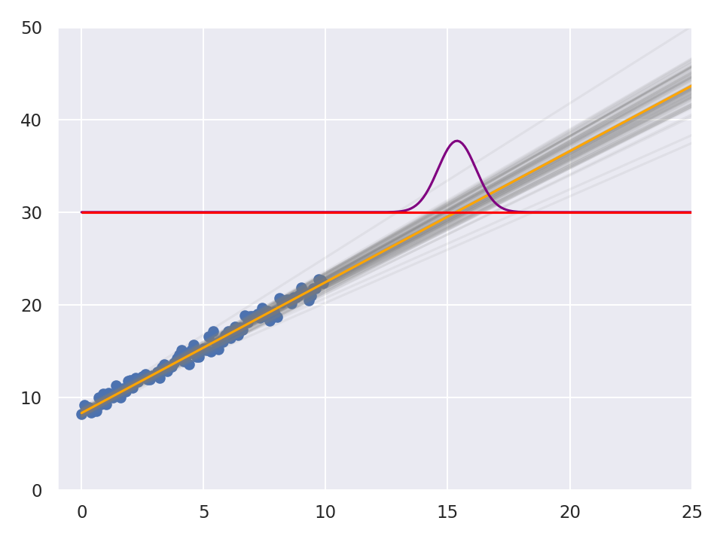
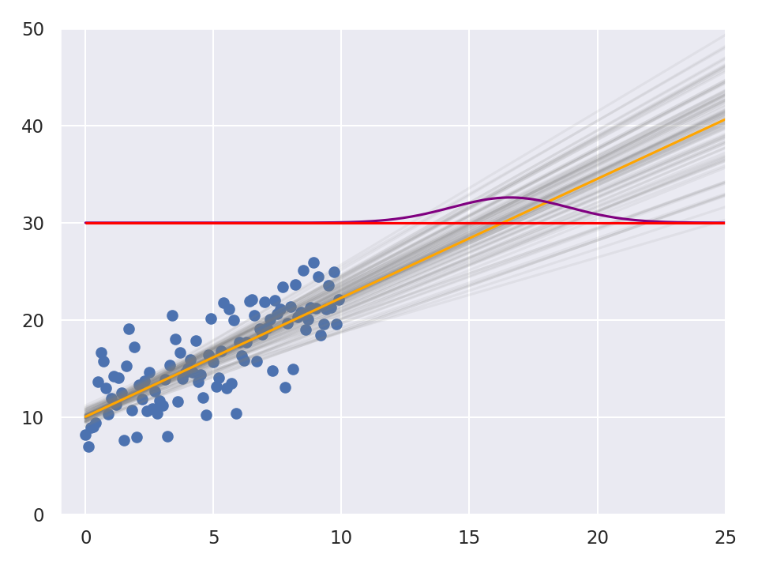
Multi-model Deep Learning: RUL Est.
Test an ensemble of models

Slide 48
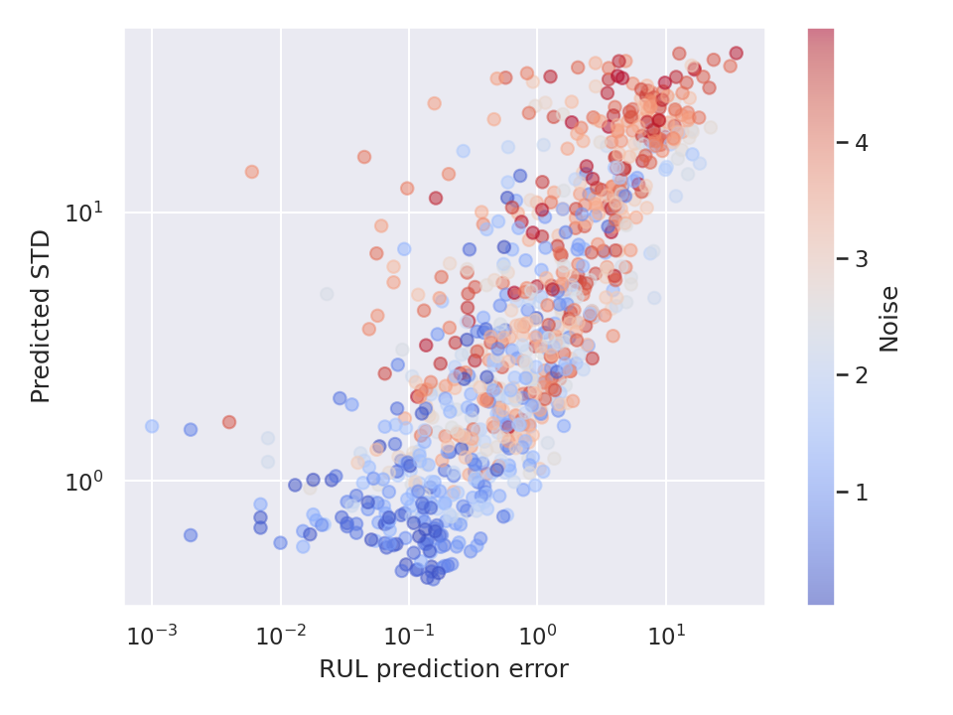
Multi-model Deep Learning: RUL Est.
Correlating predicted STD to error

Slide 49
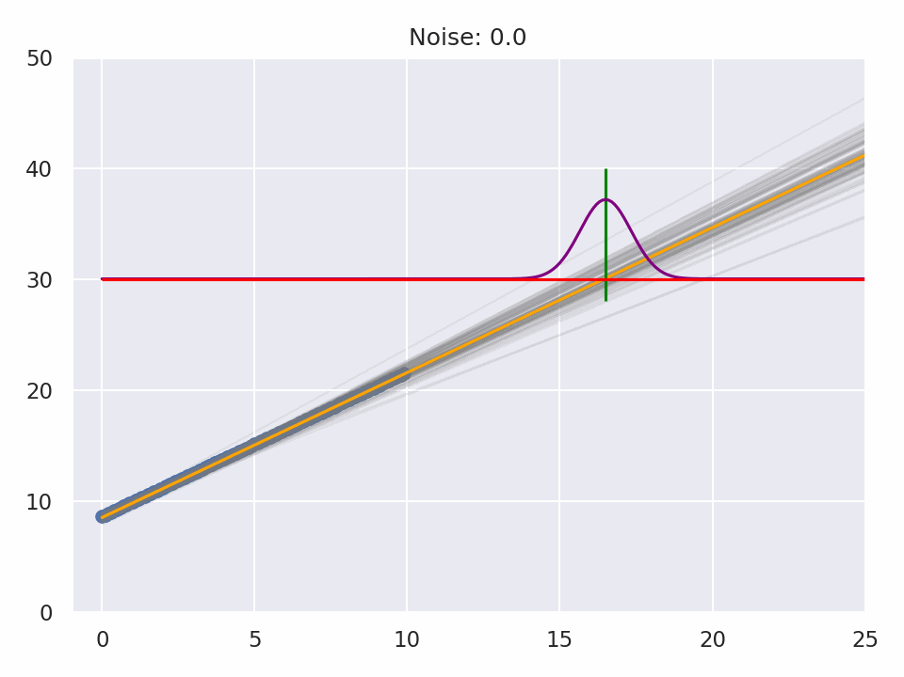
Multi-model Deep Learning: RUL Est.
Visualizing predicted STD to error

Slide 50
Multi-model Deep Learning: RUL Est.
Handling dropped/missing data

Slide 51
Multi-model Deep Learning
Health diagnostics: Classification
Notebook: 4 Signal diagnostics, ensemble DL

Slide 52
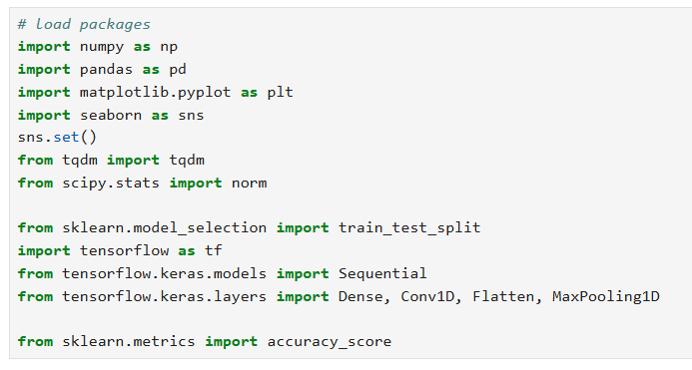
Multi-model Deep Learning: Diagnostics
New packages
1D CNNs for direct signal processing

Slide 53
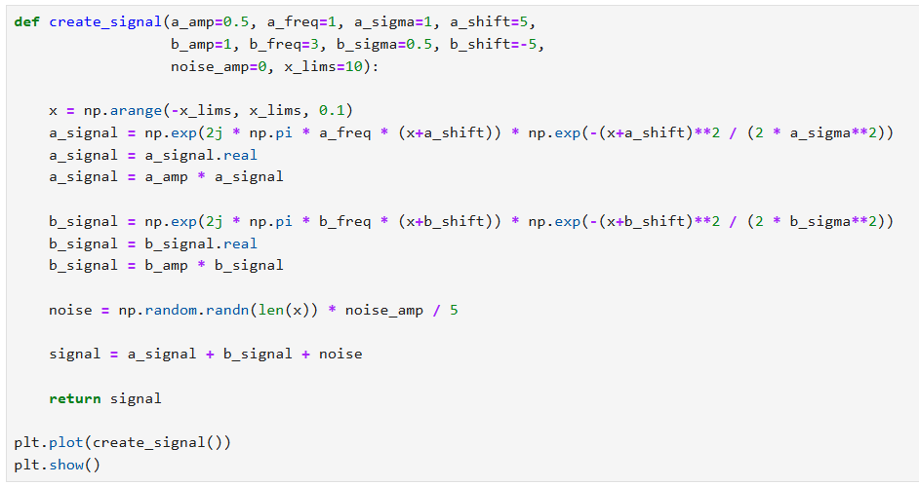
Multi-model Deep Learning: Diagnostics
Problem statement / data generator

Slide 54
Multi-model Deep Learning: Diagnostics
Problem statement / data generator
X sequence
a-type signal
b-type signal
Add noise
Aggregate signal

Slide 55
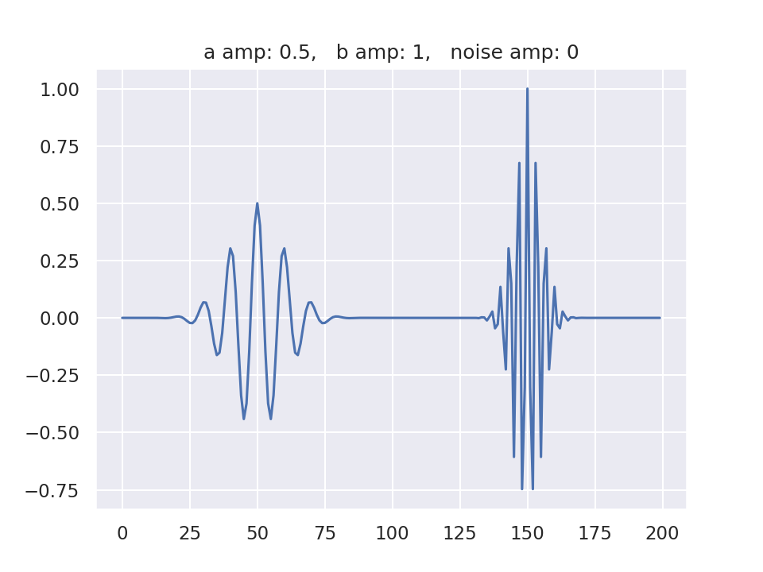
Multi-model Deep Learning: Diagnostics
Problem statement / data generator

Slide 56
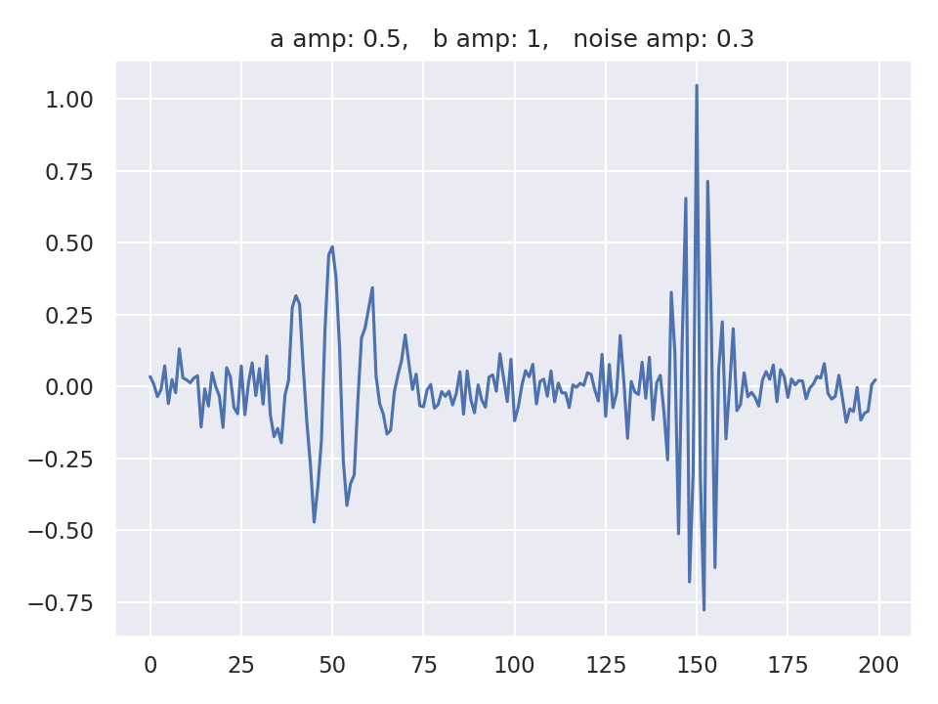
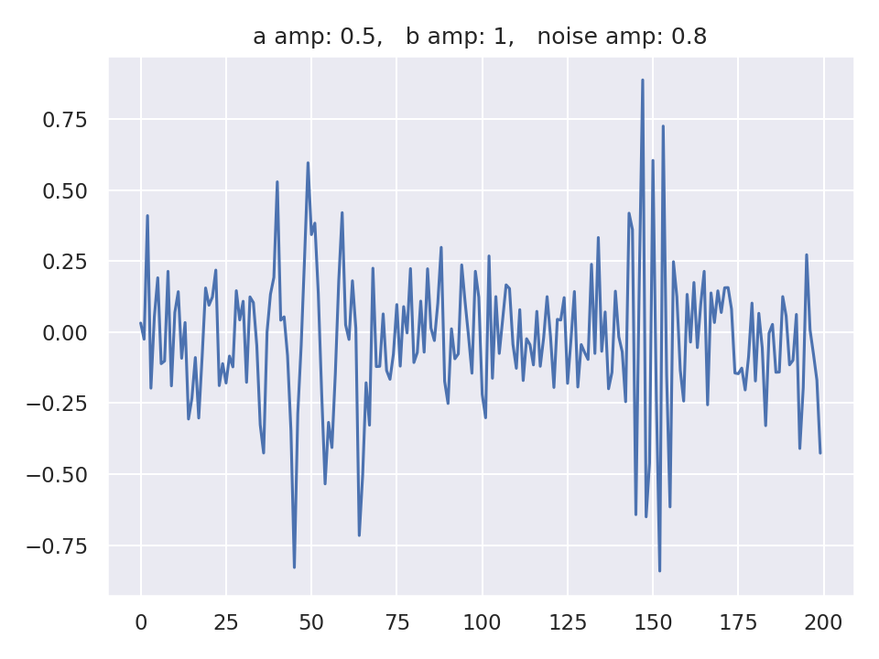
Multi-model Deep Learning: Diagnostics
Problem statement / data generator

Slide 57
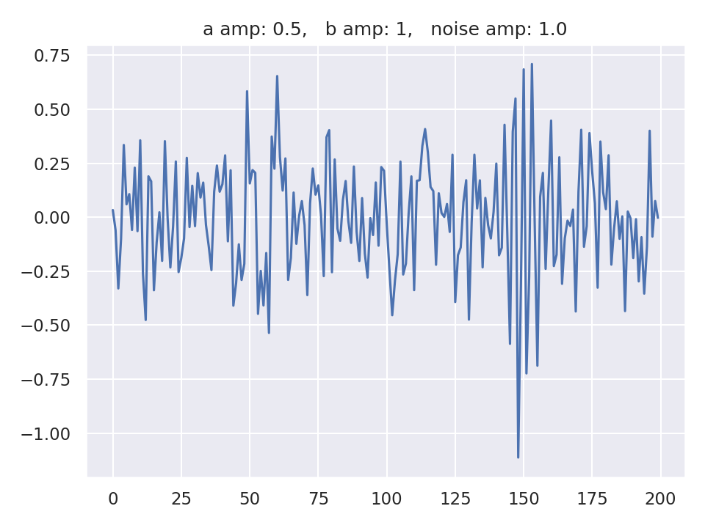
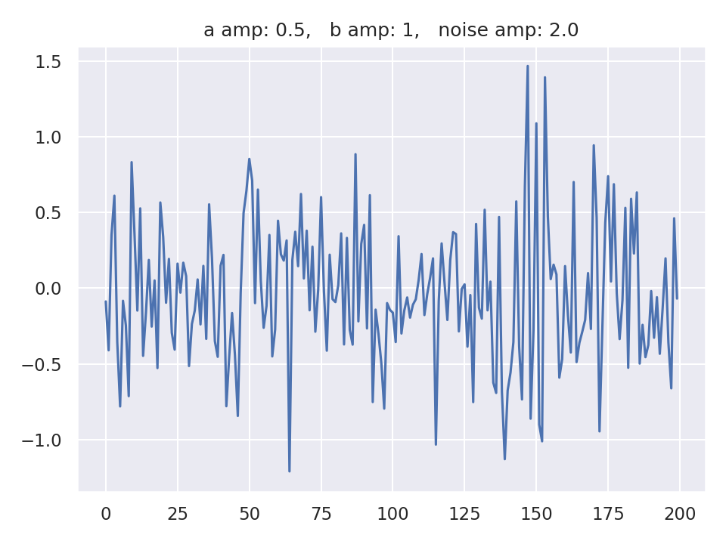
Multi-model Deep Learning: Diagnostics
Problem statement / data generator

Slide 58
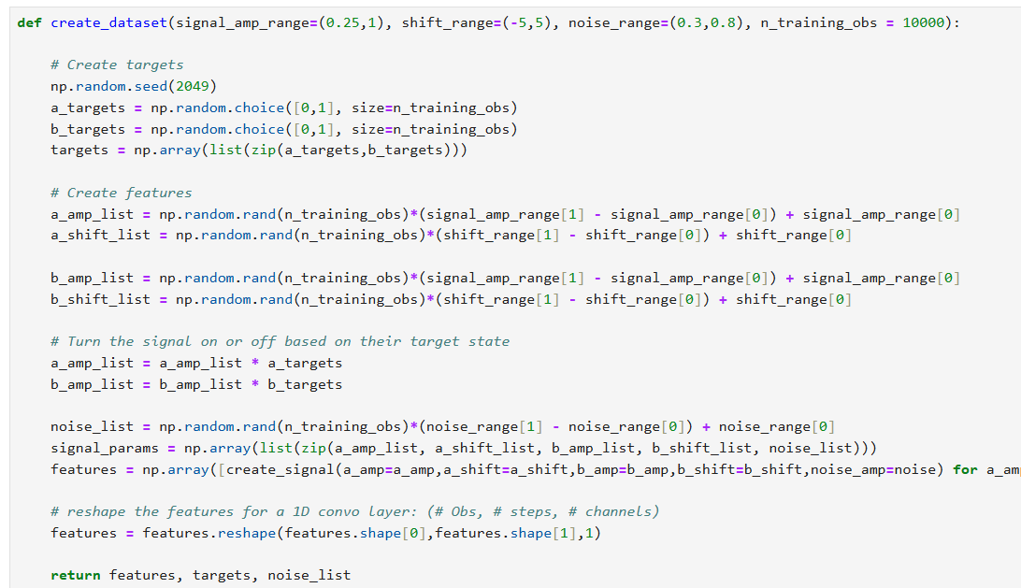
Multi-model Deep Learning: Diagnostics
Problem statement / data generator

Slide 59
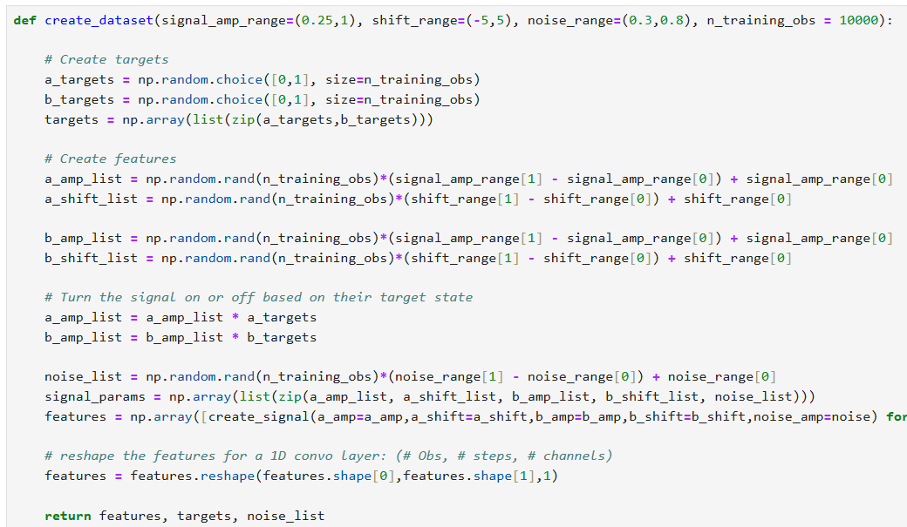
Multi-model Deep Learning: Diagnostics
Problem statement / data generator
Define which signals are present
a-signal parameters
b-signal parameters
Turn signals on/off
Produce feature signals

Slide 60
Multi-model Deep Learning: Diagnostics
Problem statement / data generator
Reshape the input vector

Slide 61
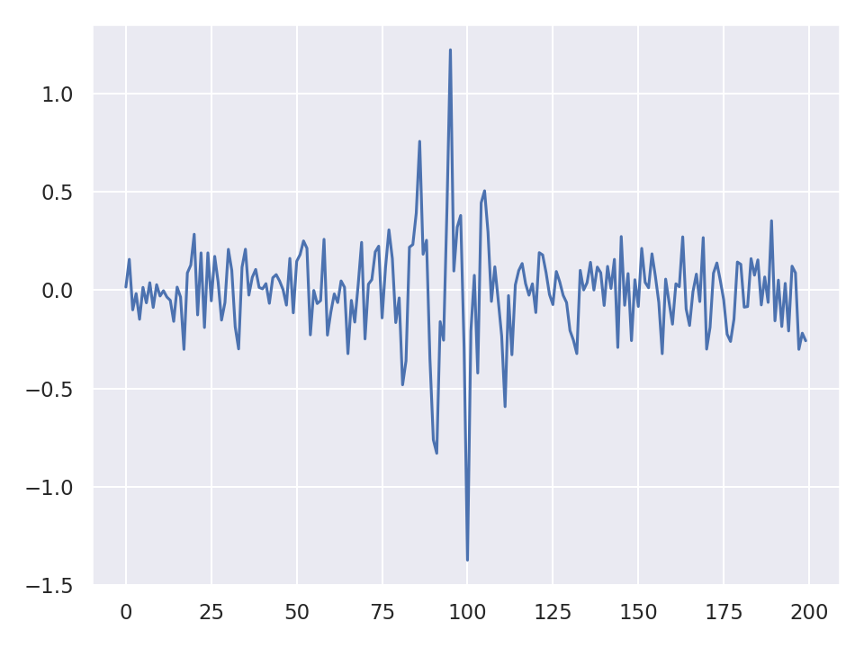
Multi-model Deep Learning: Diagnostics
Problem statement / data generator

Slide 62
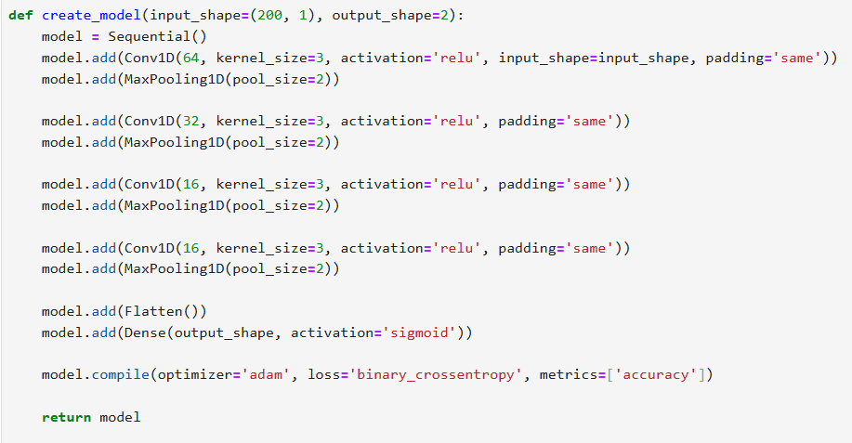
Multi-model Deep Learning: Diagnostics
Deep learning model architecture

Slide 63
Multi-model Deep Learning: Diagnostics
Deep learning model architecture
Vanilla CNN
Sigmoid
Binary cross-entropy

Slide 64
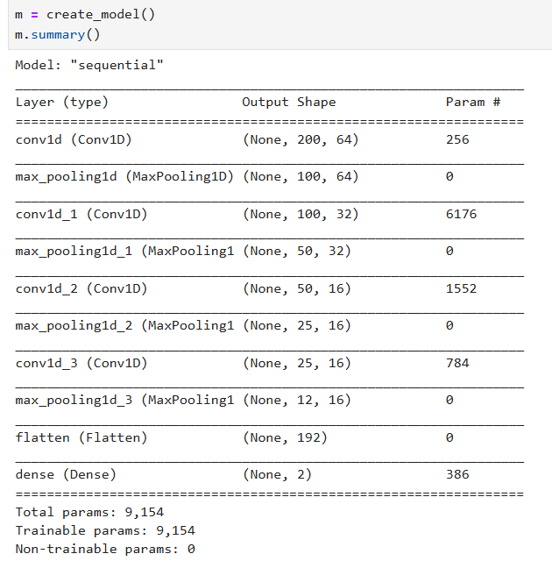
Multi-model Deep Learning: Diagnostics
Deep learning model architecture

Slide 65
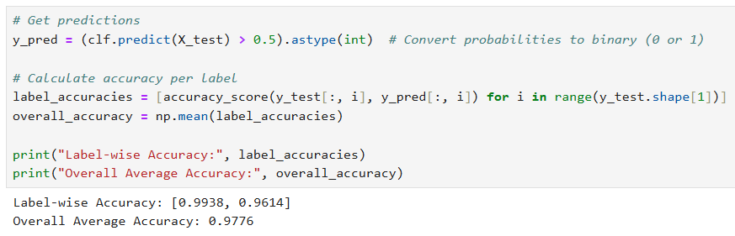
Multi-model Deep Learning: Diagnostics
Single model performance

Slide 66
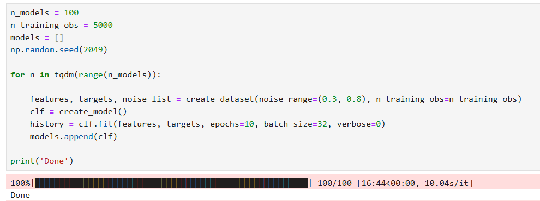
Multi-model Deep Learning: Diagnostics
Train an ensemble of models

Slide 67
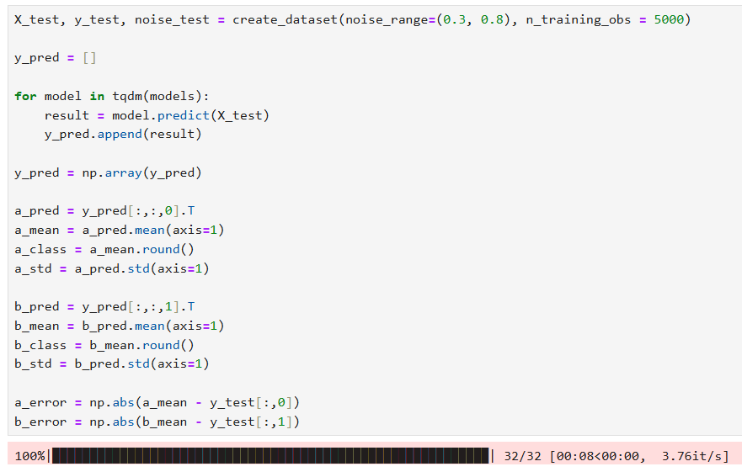
Multi-model Deep Learning: Diagnostics
Test an ensemble of models

Slide 68
Multi-model Deep Learning: Diagnostics
Test an ensemble of models
a-signal stats
b-signal stats
error

Slide 69
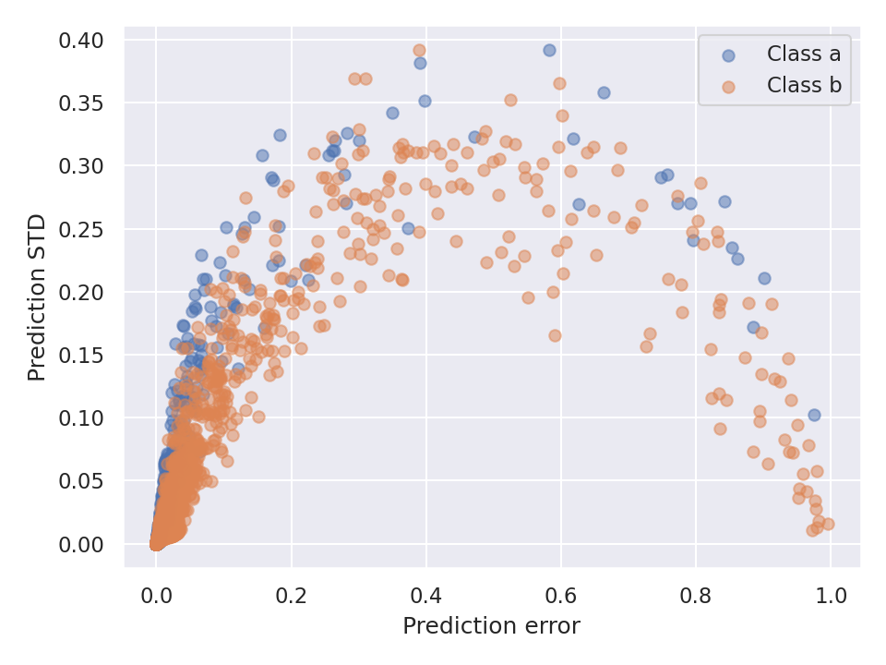
Multi-model Deep Learning: Diagnostics
Test an ensemble of models

Slide 70
Masksemble Deep Learning
Notebook: 5 Deep learning masksensemble

Slide 71
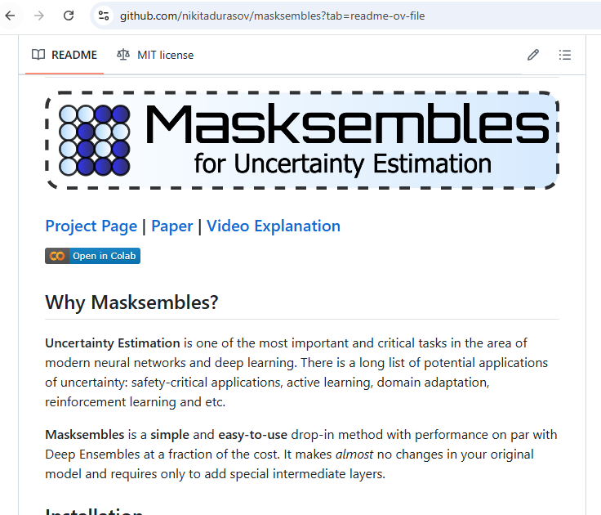

About maskensmble
https://github.com/nikitadurasov/masksembles

Slide 72
About maskensmble
Predictive uncertainty in Deep Learning
Batch Ensembling
1.05
0.98
1.02
1.016 ± 0.028

Slide 73
About maskensmble
Predictive uncertainty in Deep Learning
Batch Ensembling
Monte-Carlo DropOut
1.05
0.98
1.02
1.05
0.98
1.02
1.016 ± 0.028
1.016 ± 0.028

Slide 74

About maskensmble
Predictive uncertainty in Deep Learning
Batch Ensembling
Monte-Carlo DropOut

Slide 75

About maskensmble
Input

Slide 76
About maskensmble
Input
Batched Copies

Slide 77
About maskensmble
Neural Network with Masksemble layers (Subnetworks)
Input
Batched Copies

Slide 78
About maskensmble
Subnetwork 1
Subnetwork 2
Subnetwork 3
Subnetwork 4
Input
Batched Copies
Neural Network with Masksemble layers (Subnetworks)

Slide 79
About maskensmble
Subnetwork 1
(0.52, 0.63)
Subnetwork 2
(0.47, 0.61)
Subnetwork 3
(0.53, 0.65)
Subnetwork 4
(0.55, 0.58)
Input
Batched Copies
Neural Network with Masksemble layers (Subnetworks)

Slide 80

About maskensmble
Subnetwork 1
(0.52, 0.63)
a-mean
c-mean
Subnetwork 2
(0.47, 0.61)
Subnetwork 3
(0.53, 0.65)
Variance
Subnetwork 4
(0.55, 0.58)
Input
Batched Copies
Neural Network with Masksemble layers (Subnetworks)
Model’s confidence in the pick

Slide 81
Maskensmbles basics

Slide 82

Maskensmbles: RUL Estimation

Slide 83

Maskensmbles: RUL Estimation

Slide 84

Maskensmbles: RUL Estimation
Create DL model with maskensembles layers

Slide 85
Maskensmbles: RUL Estimation
Create DL model with maskensembles layers

Slide 86
Maskensmbles: RUL Estimation
Create DL model with maskensembles layers
Number masks
Mask coherence

Slide 87

Maskensmbles: RUL Estimation
Create DL model with maskensembles layers

Slide 88
Maskensmbles: RUL Estimation
Maskensembles considerations
Each mask is linked to a batch position

Slide 89
Maskensmbles: RUL Estimation
Maskensembles considerations
Each mask is linked to a batch position
Batch
Input vector 1
Input vector 2
Input vector 3
Masking layer

Slide 90
Maskensmbles: RUL Estimation
Maskensembles considerations
Each mask is linked to a batch position
Batch
Input vector 1
Input vector 2
Input vector 3
Batch
Input vector 1
Input vector 2
Input vector 3
Batch
Input vector 1
Input vector 2
Input vector 3
Batch
Input vector 1
Input vector 2
Input vector 3

Slide 91
Maskensmbles: RUL Estimation
Maskensembles considerations
Each mask is linked to a batch position
Mask size must equal batch size
During training and inference
Batch size (and mask size) are also the number of “independent” models
When training, training dataset size must be divisible by the batch size

Slide 92

Maskensmbles: RUL Estimation
Training DL maskensembles model

Slide 93

Maskensmbles: RUL Estimation
Testing DL maskensembles model

Slide 94

Maskensmbles: RUL Estimation
Testing DL maskensembles model

Slide 95
Maskensmbles: RUL Estimation
Testing DL maskensembles model
10,000,000 predictions = 10,000 repeated 100 times

Slide 96

Maskensmbles: RUL Estimation
Testing DL maskensembles model
Reshape the pred data for statistical analysis

Slide 97

Maskensmbles: RUL Estimation
Testing DL maskensembles model

Slide 98

Maskensmbles: RUL Estimation
Testing DL maskensembles model

Slide 99
Maskensmbles: RUL Estimation
Create DL model with maskensembles layers

Slide 100

Maskensmbles: RUL Estimation
Improving the model
Bigger training dataset
Bigger model
Longer training

Slide 101

Maskensmbles: RUL Estimation
Improving the model
Old model
New model

Slide 102
Masksemble 2024 Data Challenge
Notebook: 6 PHM DC with masksembles

Slide 103
2024 PHM DC Competition

Slide 104

2024 PHM DC Competition

Slide 105

2024 PHM DC Competition

Slide 106

2024 PHM DC Competition

Slide 107

2024 PHM DC Competition

Slide 108
2024 PHM DC Competition

Slide 109

Thanks
Actionable Intelligence through Analytics

Slide 110
Technology Review

